Slide 1
Queue and Stack
18ESC108A Elements of Computer Science and Engineering
B. Tech. 2018
Ami Rai
Roopa G
Chaitra S
Department of Computer Science and Engineering
Faculty of Engineering and Technology
Ramaiah University of Applied Sciences

Slide 2
Objectives
At the end of this lecture, student will be able to
Use the operations of a queue data structure
Use the operations of a stack data structure

Slide 3
Contents
Queues
Stacks

Slide 4
Queue
Represent waiting lines
the first person in line is serviced first, and other customers enter the line only at the end and wait to be serviced
first-in, first-out (FIFO) data structure
Enqueue
Insertions are made at the back (tail of a queue)
Dequeue
Deletions are made from the front (head of a queue)

Slide 5
Queues in Computer Systems
Accessing peripherals: Requests are queued
Print spooling - A multiuser environment may have only a single printer
Kernel scheduling
CPU and other resources are scheduled by the kernel and made available to processes
Many computers have only a single processor, so only one user at a time may be serviced. Entries for the other users are placed in a queue
Information packets wait in queues in computer networks
The routing node routes one packet at a time

Slide 6
List Based Realisation of Queue ADT
class Queue:
def __init__(self):
self.items = []
def isEmpty(self):
return self.items == []
def enqueue(self, item):
self.items.insert(0,item)
def dequeue(self):
return self.items.pop()
def size(self):
return len(self.items)

Slide 7
The Stack ADT
Stack - A special kind of Vector where insertions and deletions are allowed at one end only (“top”)
Last-in,first-out (LIFO) data structure

Slide 8
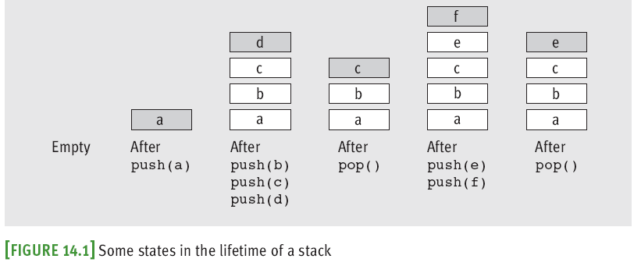
The Stack ADT – Basic Operations
Basic operations: push and pop
push(a): Puts element a at the top of the Stack
pop(): Removes and returns the top-most element from the Stack

Slide 9
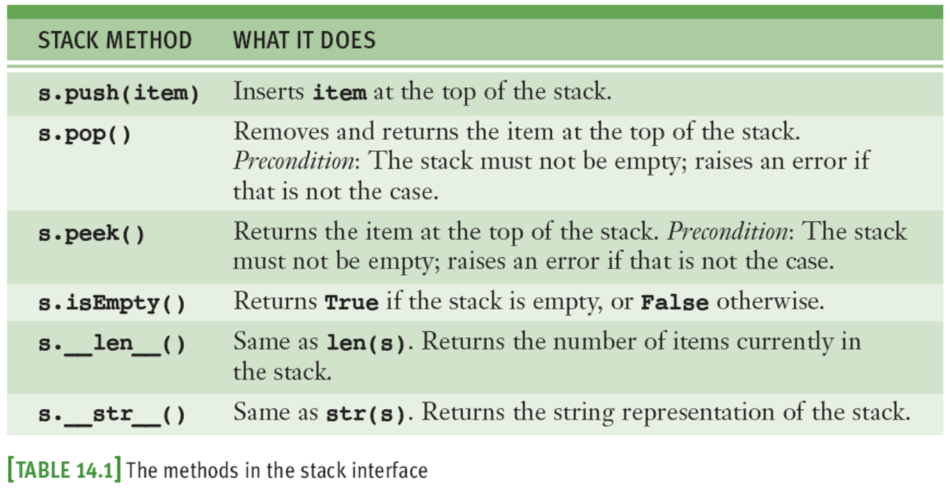
Stack Interface

Slide 10
Overflow and Underflow
It is important to consider the cases full Stack and empty Stack
Stack overflow
When the stack contains equal number of elements as per its capacity and no more elements can be added
Stack underflow
When there is no element in the stack or the stack holds elements less than its capacity

Slide 11
System Applications of Stack
Stack is one of most used data structure for system programming
Compilers use it all the time to impalement function calls
Function call: push local environment and return address
Return: pop return address and local environment
In evaluating arithmetic expressions
Recursive function call:

Slide 12
Function Call Stack
When a program calls a function, the called function must know how to return to its caller, so the return address of the calling function is pushed onto the program execution stack
sometimes referred to as the function call stack
Activation record or stack frame of the function call
a portion of the program execution stack
memory for the local variables used in each invocation of a function during a program’s execution

Slide 13
Function Call Stack contd.
When a function call is made
the activation record for that function call is pushed onto the program execution stack
When the function returns to its caller
the activation record for this function call is popped off the stack and those local variables are no longer known to the program
stack overflow
Error occurs if more function calls occur than can have their activation records stored on the program execution stack

Slide 14
Summary
Stack and Queue ADTs are data structures in which there is restriction on the insertion and deletion of elements
In a Queue, elements can be inserted at one end and can be removed only from the other end
In a Stack, elements can be inserted and removed only at one end

